Slide 1
Measurement – Perimeter
Miss Lum
Year 11 Essentials

Slide 2

Learning Outcomes
1.3.4 Calculate perimeters of familiar shapes, including: triangles, squares, rectangles and composites of these

Slide 3

Quickwrite
60 seconds to write down words relating to Perimeter
Prompts
Definition
Shapes
Use
Measurement units

Slide 4
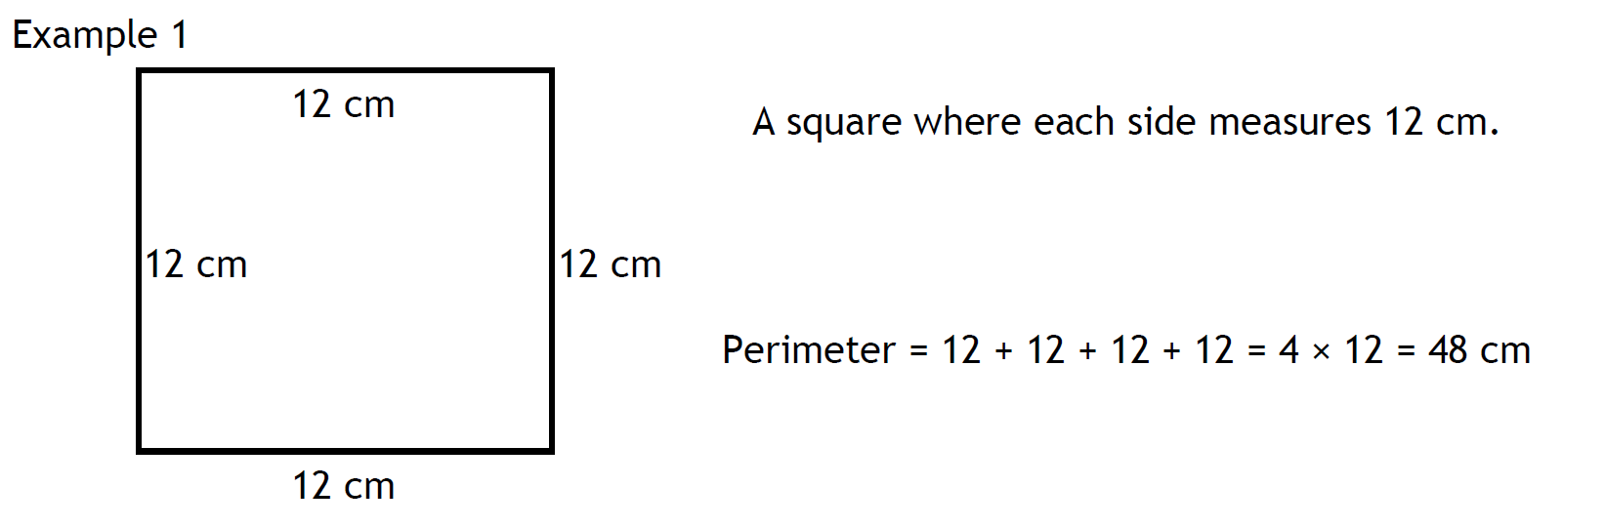
24
7
30
Perimeter
Date: /03/2018
EQ – What is Perimeter?
The perimeter of a shape is the total length of the outside of the shape. It is found by adding together the lengths of all the sides.

Slide 5
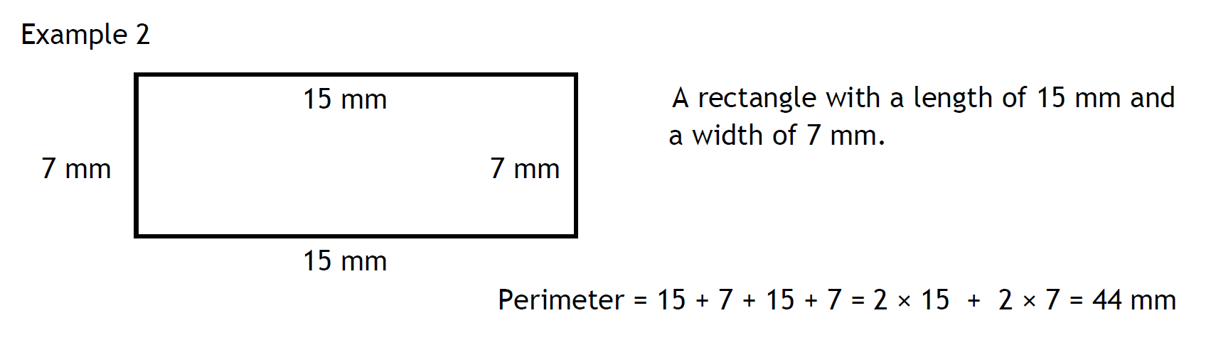
24
7
30
Perimeter
Date: /03/2018
EQ – What is Perimeter?

Slide 6
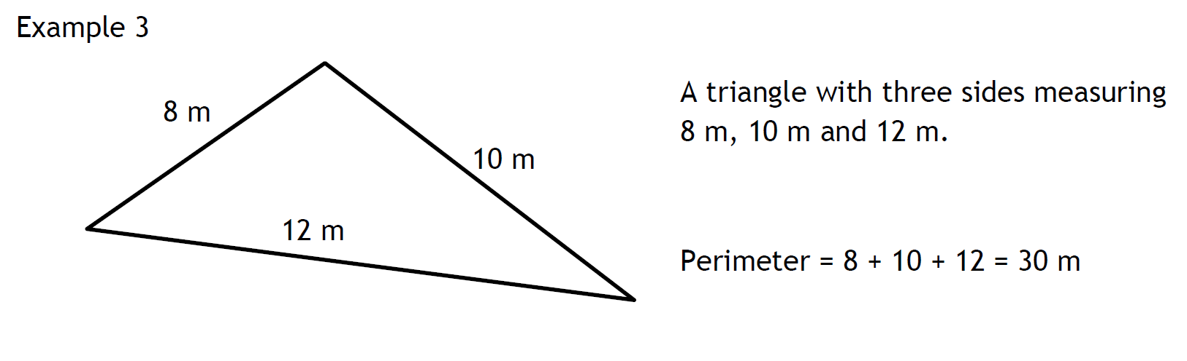
24
7
30
Perimeter
Date: /03/2018
EQ – What is Perimeter?

Slide 7
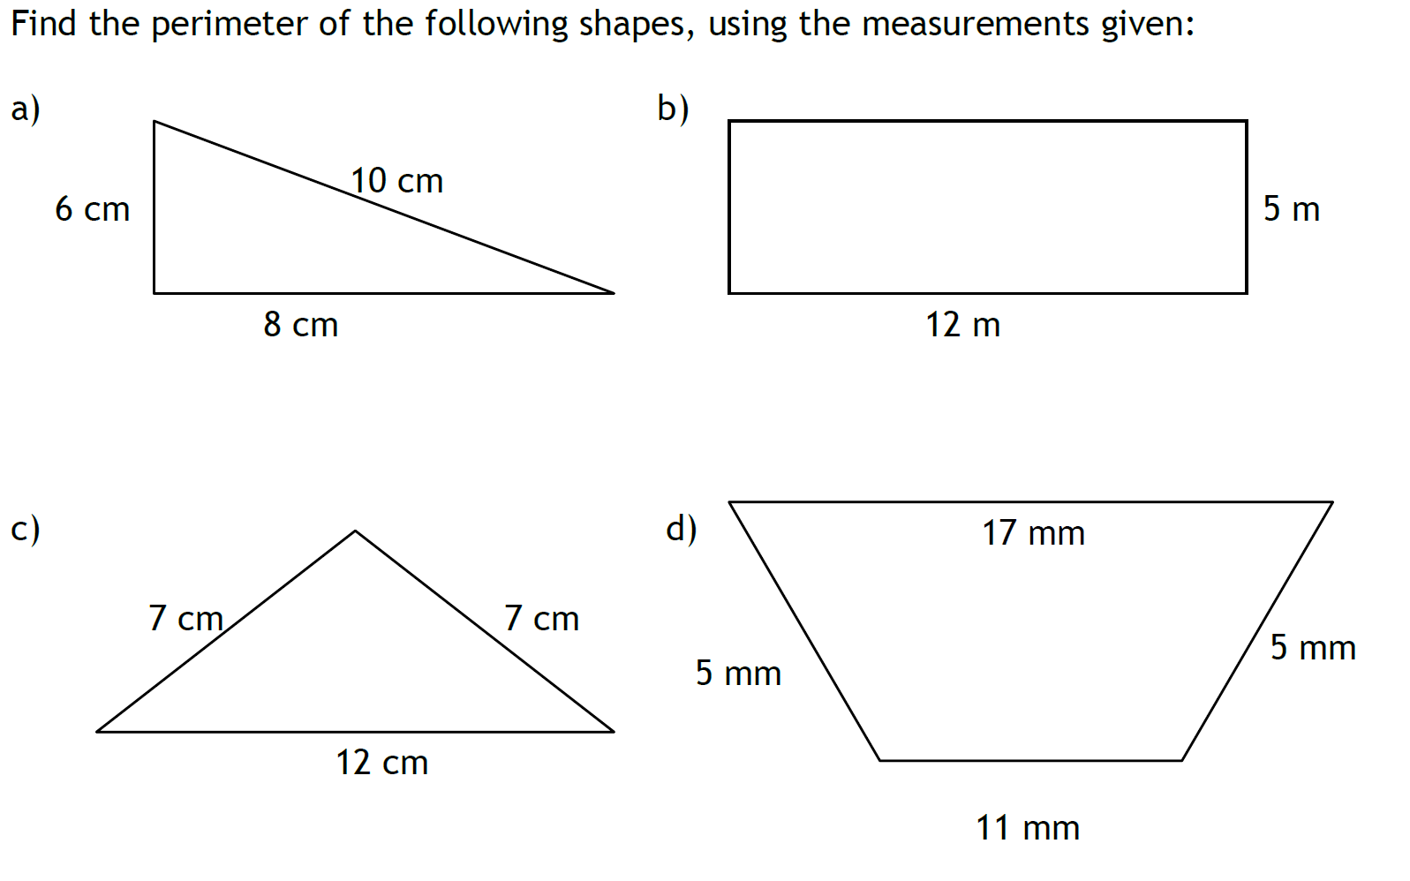
Quick Review

Slide 8
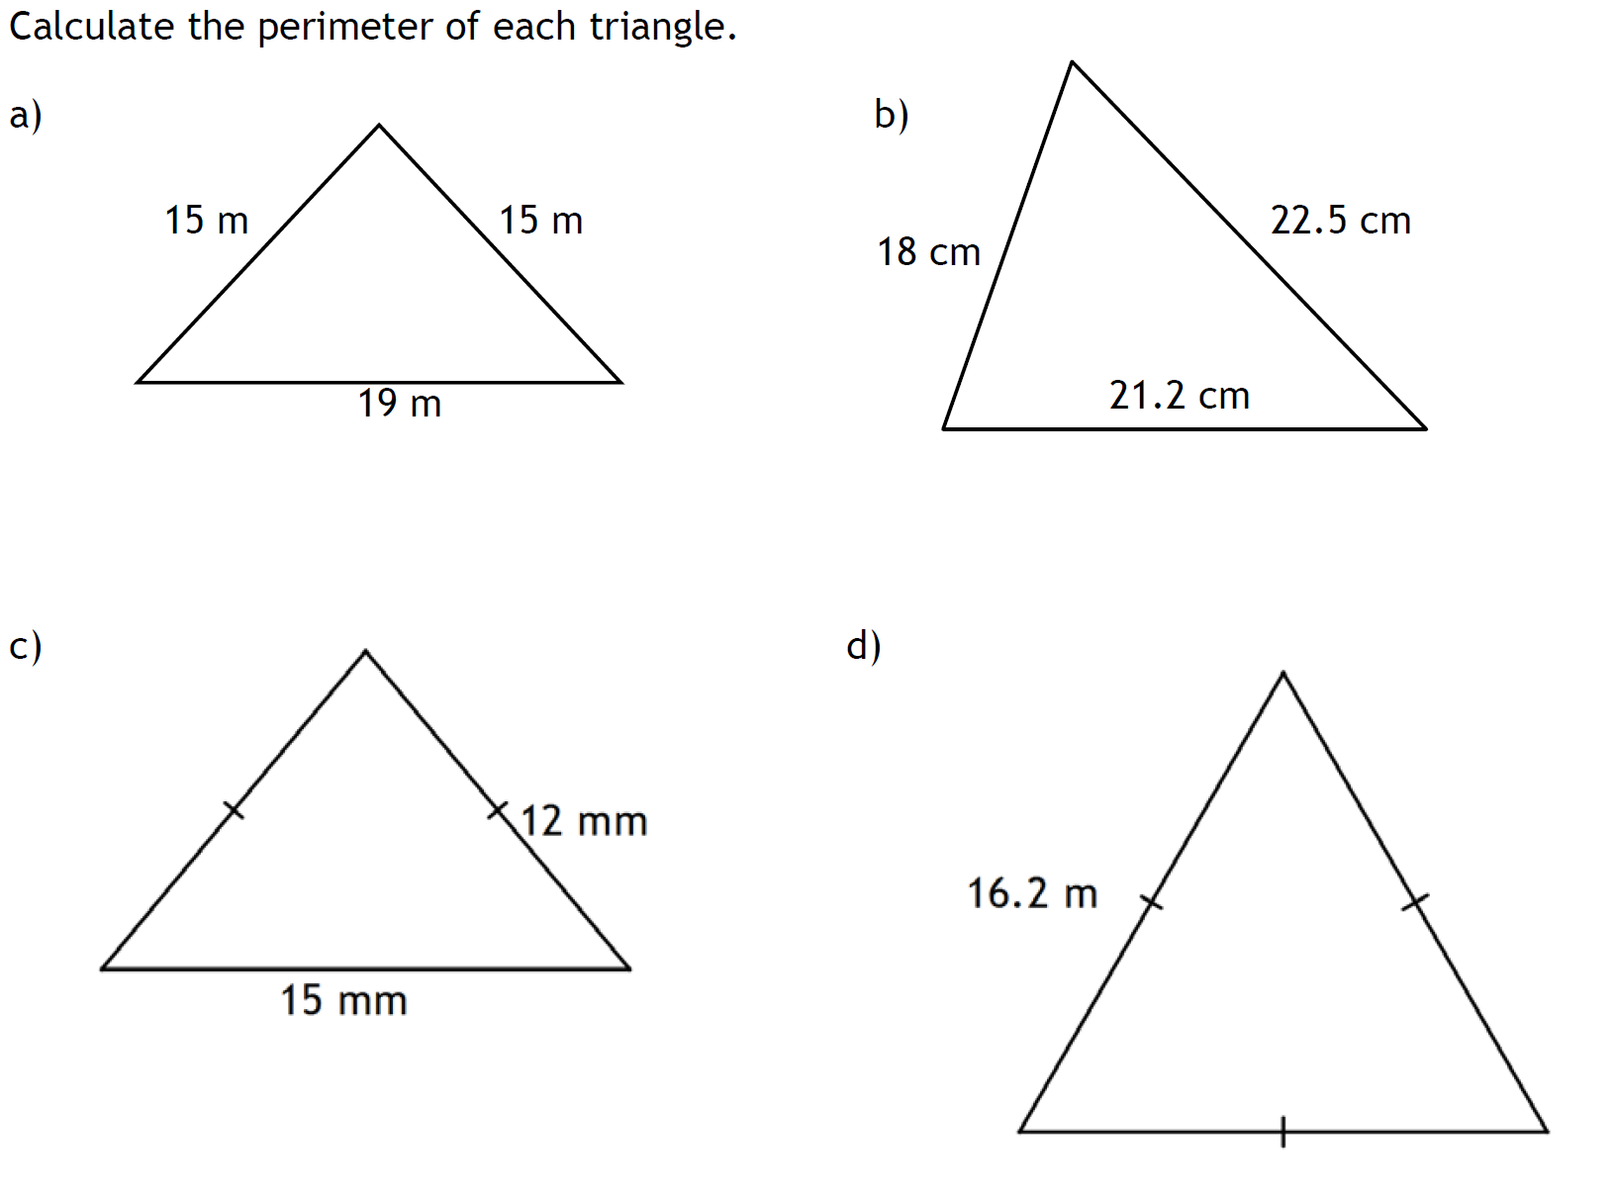
Quick Review

Slide 9
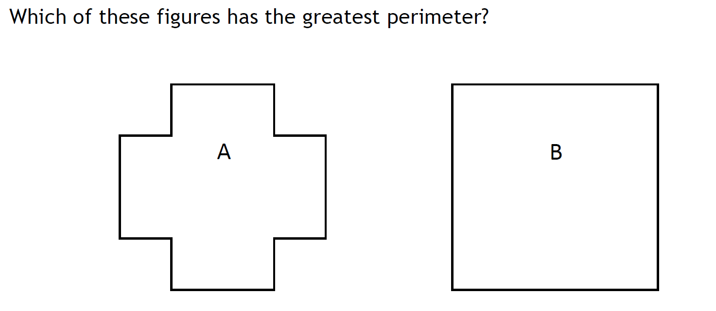
A Puzzle
Notes:
This is a prompt for a 5 – 10 min class discussion. Focus on literacy and numeracy skills used to communicate ideas.

Slide 10
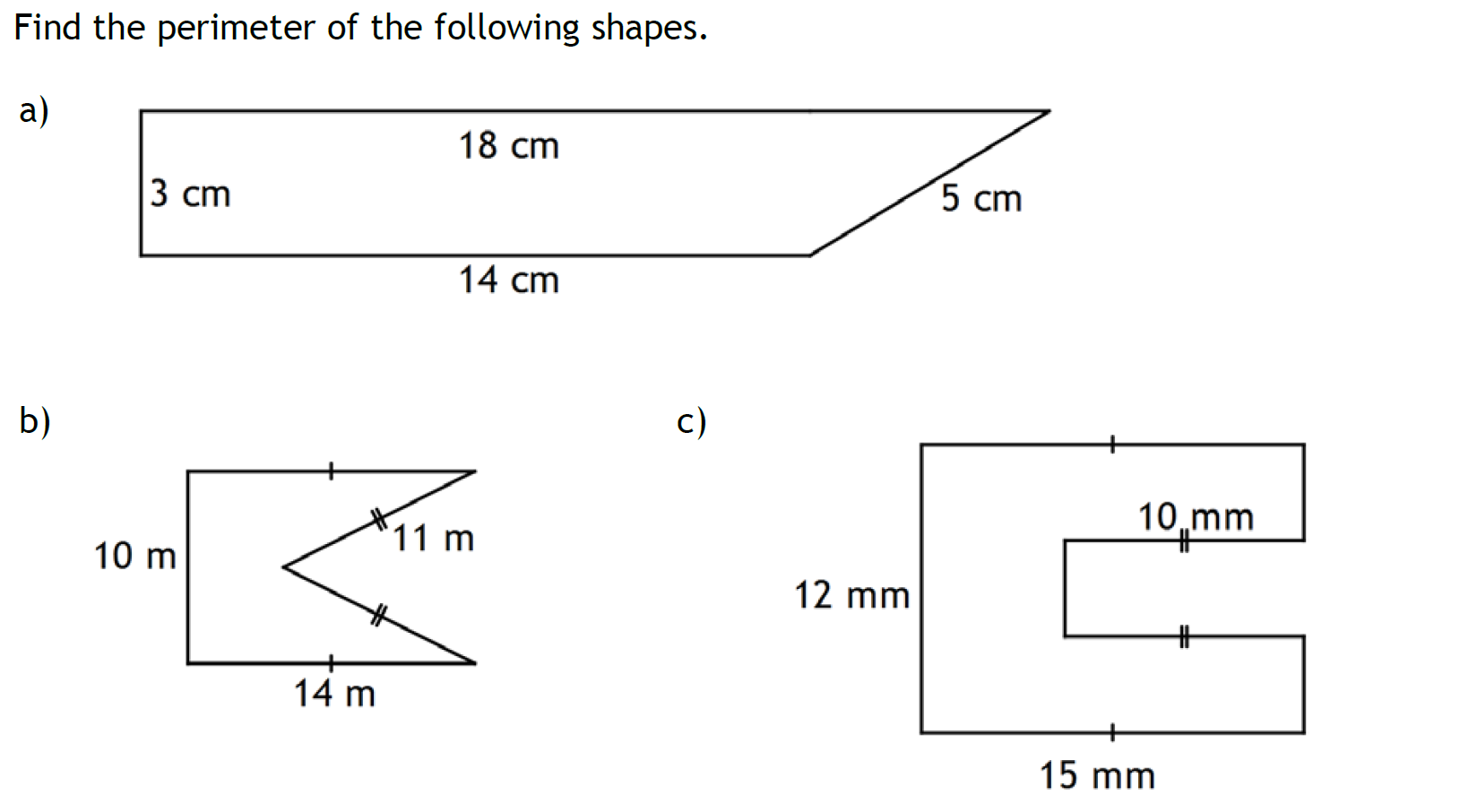
Guided Practice
Notes:
Focus:
Working out and inclusion of units of measurements
Interpreting hatch marks in diagrams showing sides of equivalent lengths

Slide 11
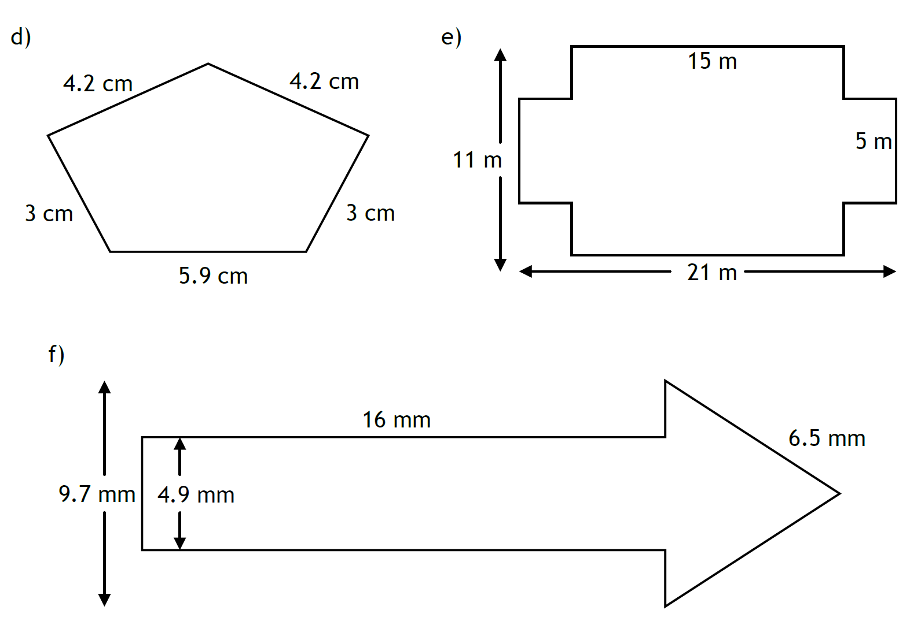
Task
Notes:
Focus:
- Strategies to solve for information that is not explicitly provided.

Slide 12
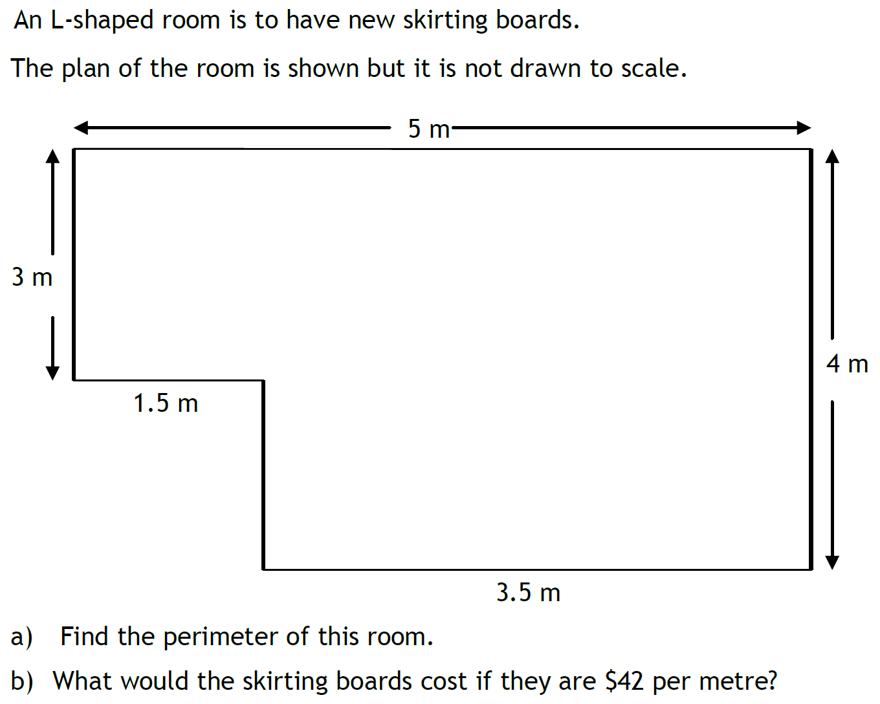
Task
Notes:
Focus:
Working out
Application of rates (Previous Unit of Work)

Slide 13
Powerwrite
60 seconds to write about Perimeter

Slide 14
Application of SKills
Ellery & Strickland
Chapter 3.2, Questions 11 – 16, pp. 56 – 58

